Slide 1


CONCLUSION
TECHNOLOGIES
I USED
INTRODUCTION
P-VPN Method
4^{th Year Project} ^{By Price Asemota}
GRAPHS
ABOUT ME &
MY PROJECT
WIREGUARD VS
OPENVPN
WHY I CHOSE
THIS TOPIC

Slide 2
CONCLUSION
^{About me & My Project} My name is Price Asemota. I am also the captain and Co president of the NCI basketball team. My project is a web application using different technologies to compare and contrast the differences between two mainstream VPN’s, Wireguard and Open VPN, to guide people in figuring out which VPN is best to use.
My web app also so has other features likes a speed tester functionality, where users can test their internet speed when connected to a VPN.
TECHNOLOGIES
I USED
INTRODUCTION
GRAPHS
ABOUT ME &
MY PROJECT
WIREGUARD VS
OPENVPN
WHY I CHOSE
THIS TOPIC

Slide 3

CONCLUSION
^{Why I chose this topic} During one of my Networking modules in third year, my lecturer demonstrated how effortless it was for him to access our IP addresses as soon as we connected to his mobile hotspot or the public wifi provided by the college. Realising this, I began researching VPNs I could use to protect myself and feel less exposed. Due to this, I had the idea why not create an application to show people the differences between two VPN’s, giving them detailed information to simplify things for themselves without the need for any research. With this, people can choose which VPN they prefer.
TECHNOLOGIES
I USED
INTRODUCTION
GRAPHS
ABOUT ME &
MY PROJECT
WIREGUARD VS
OPENVPN
WHY I CHOSE
THIS TOPIC

Slide 4

CONCLUSION
Recording-20241213_233447.webm
^{Requirement Engineering}
This system must have compare OpenVPN and WireGuard on factors like speed, processing power, Traffic handling and more.
There will also be a speed test API that will allow users to measure VPN performance.
Its also important that users can easily navigate theyre way through my web app and perform speed tests and see comparisons.
TECHNOLOGIES
I USED
INTRODUCTION
GRAPHS
ABOUT ME &
MY PROJECT
WIREGUARD VS
OPENVPN
WHY I CHOSE
THIS TOPIC

Slide 5
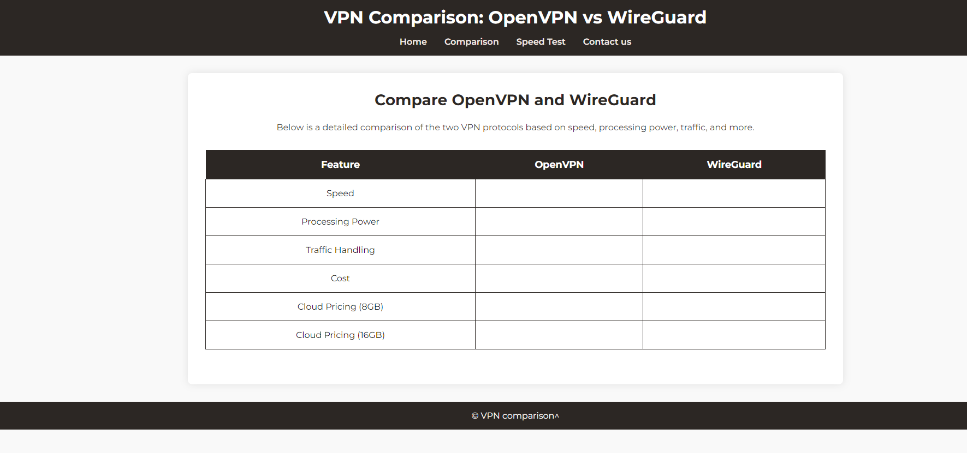
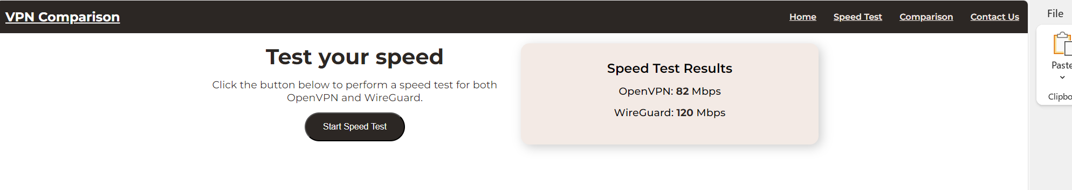
CONCLUSION
^{WireGuard vs OpenVPN Graphs}
TECHNOLOGIES
I USED
INTRODUCTION
GRAPHS
ABOUT ME &
MY PROJECT
WIREGUARD VS
OPENVPN
WHY I CHOSE
THIS TOPIC

Slide 6

CONCLUSION
^{Technologies I used} API’s : I will be using a speed tester API (SpeedTester.net) This will allow users to click the “Test speed” button which triggers the JavaScript function, and from there the function sends a request to the API to begin the test, which the results will then display on the screen. Cloud servers: I am using different cloud servers test both OpenVPN and WireGuard on like AWS for example.
Languages: and I will be using html CSS and Javacript to design the web application
TECHNOLOGIES
I USED
INTRODUCTION
GRAPHS
ABOUT ME &
MY PROJECT
WIREGUARD VS
OPENVPN
WHY I CHOSE
THIS TOPIC

Slide 7

CONCLUSION
TECHNOLOGIES
I USED
INTRODUCTION
GRAPHS
Thank you for listening !
Any Questions?
ABOUT ME &
MY PROJECT
WIREGUARD VS
OPENVPN
WHY I CHOSE
THIS TOPIC

